Slide 1
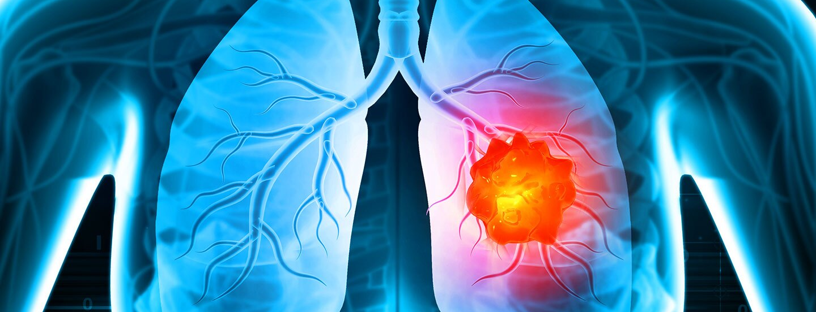

Lung Cancer CASE STUDY
A research project by Gourab

Slide 2
Contents
Objectives
Data Analysis
Important factors
Demographic Factors
Lifestyle Factors
Physical and Medical Indicators Revenue
Psychological and Emotional Factors
Findings
Table Analysis
Case Study
Multi-Symptom Risk Evaluation

Slide 3
Case study
This case study consists of 1 dataset only.
The dataset consists details of patients who was affected or not affected by lung cancer.

Slide 4
Objectives
Analyze the risk factors associated with lung cancer based on patient data and identify key predictors.

Slide 5


Data Analysis
For analysing the data, various factors are affecting patients(i.e the important attributes) should be listed out.
In this case study, there is 1 table cancer which is consisting of patients’ details.

Slide 6
Important factors to optimize business
Demographic Factors (Gender and Age wise lung cancer risk)
Lifestyle Factors (Smoking and Alcohol Consumption)
Physical and Medical Indicators (Chronic Disease and Yellow Fingers)
Psychological and Emotional Factors (Anxiety and Fatigue)
Multi-Symptom Risk Evaluation (Coughing, Shortness of breath and Chest pain)

Slide 7
Table Analysis
This dataset consists of 1 table.
It consists 309 records of patients.

Slide 8
Demographic Factors (Gender wise Lung Cancer risk)
145 male patients vs. 125 female patients diagnosed with lung cancer.
While men have slightly higher cases, the difference is not drastic, indicating that lung cancer affects both genders significantly.

Slide 9
Demographic Factors (Age group wise Lung Cancer risk)

Slide 10
Age group wise Lung Cancer risk
Lung cancer risk increases significantly with age.
The majority of lung cancer patients are in the 60+ age group category.
But a huge jump in lung cancer cases in the 51-60 age group suggests that this is a high-risk group.
Younger age groups (21-40) show very few cases, possibly indicating that lung cancer develops over decades.

Slide 11
Lifestyle Factors (Smoking and Alcohol Consumption)

Slide 12
Lifestyle Factors
155 lung cancer cases (57%) are from smokers, showing a strong link between smoking and lung cancer.
Although smoking is a major risk factor, lung cancer prevention should also address non-smoking causes.
165 lung cancer cases (61%) are from alcohol consumers, compared to 105 cases (39%) in non-drinkers.
Lung cancer prevention should consider alcohol consumption as a possible risk factor alongside smoking.

Slide 13
Physical and Medical Indicators (Chronic Disease and Yellow Fingers)

Slide 14
Physical and Medical Indicators
142 lung cancer patients (53%) have a chronic disease, while 128 cases (47%) do not.
Although chronic disease is a contributing factor, a significant number of lung cancer cases occur in individuals without pre-existing conditions.
163 lung cancer patients (60%) have yellow fingers, while 107 cases (40%) do not.
Yellow fingers are often a sign of heavy smoking, which is a major risk factor for lung cancer.

Slide 15
Psychological and Emotional Factors (Anxiety and Fatigue)
 | ANXIETY | FATIGUE
Category 1 | 1 | 1
Category 2 | 0 | 1
Category 3 | 1 | 0
Category 4 | 0 | 0
Note : 1 means they have that problem and 0 means they have not that problem.

Slide 16
Psychological and Emotional Factors
32% patients experience both anxiety and fatigue, indicating that emotional and physical distress may coexist in lung cancer cases.
The highest number of cases (38%) are in patients with fatigue but no anxiety, suggesting fatigue is a stronger indicator of lung cancer than anxiety.

Slide 17
Multi-Symptom Risk Evaluation (Coughing, Shortness of breath and Chest pain)
 | COUGHING | SHORTNESS OF BREATH | CHEST PAIN
Category 1 | 1 | 1 | 1
Category 2 | 1 | 1 | 0
Category 3 | 0 | 0 | 1
Category 4 | 0 | 1 | 1
Category 5 | 0 | 1 | 0
Category 6 | 1 | 0 | 0
Category 7 | 0 | 0 | 0
Category 8 | 1 | 0 | 1
Note : 1 means they have that problem and 0 means they have not that
problem.

Slide 18
Multi-Symptom Risk Evaluation
The highest number of lung cancer cases (84 patients) experience all three symptoms (coughing, shortness of breath, and chest pain).
A small group (20 patients) have lung cancer without experiencing any of these symptoms, suggesting that lung cancer can sometimes develop silently.

Slide 19
Findings
Men have slightly higher lung cancer cases but both men and women are at significant risk.
Lung cancer cases increase significantly with age.
Smoking increases lung cancer risk, but non-smokers are also affected.
Alcohol consumption is linked to a higher number of lung cancer cases.
Lung cancer cases are higher in patients with chronic diseases.
Yellow fingers are associated with a higher number of lung cancer cases.
Fatigue is more common in lung cancer patients than anxiety.
Coughing, shortness of breath, and chest pain are significant indicators of lung cancer.

Slide 20
Thank You

